Slide 1
Bridge Inspection Robot Proposal Presentation
Sean Csukas
Kristen Fernandez
Erikzzon Latoja
Justin Tamayo
Sanmeshkumar Udhayakumar
Advisor: Dr. Patricio Vela

Slide 2
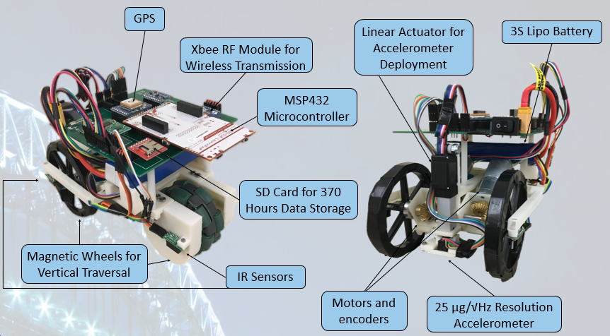
Introduction
Previous Design by Dr. Wang’s Team
The team designed a wireless sensing robot for structural health monitoring of steel structures
Replaced the old flexure-based, four-wheeled robot with a design that features upgraded electrical and mechanical components along with increased mobility
Current Design
Notes:
Kristen

Slide 3
Problem Background
The repair and maintenance of civil infrastructure systems is a constant challenge
50+% of U.S. bridges built before 1940’s
1 in 9 structurally deficient
Maintenance costs ~$20.5 billion annually; only $12.8 billion available
American Society of Civil Engineers (ASCE) gave C+ grade for bridge infrastructure in 2017 Report Card on America’s Infrastructure
Visual inspection subjective and leaves damage below surface undetectable
Notes:
Kristen

Slide 4
Solution: Structural Health Monitoring (SHM) System
Utilizes accelerometer and other sensor data
Current Solutions - Stationary sensors
Cons
Cable installation between sensors is high cost
Hard and time consuming to place and maintain
A lot of sensors needed
Resensys Senspot Sensors
For average-sized highway bridge, would need ~500 sensors * $20 = $10,000, not including installation costs
Human installation required roughly every 20 years
Notes:
Kristen

Slide 5
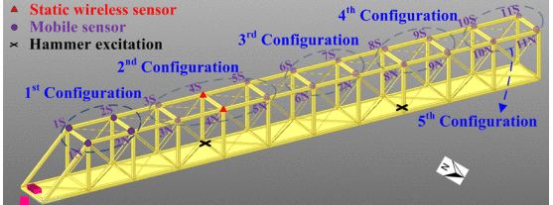
New Solution: Network of Wireless, Sensing Robots
Network of robots capable of synchronized, autonomous traversal and structural health measurement
Benefits
Only small number of robots needed to cover whole bridge
Low-cost and no installation
Challenges
No similar existing solution
Drastically more complex

Slide 6
Goals
Design and build one robot to compose the new network
The robot must be able to do the following:
Horizontally and vertically traverse steel bridges
Measure bridge vibrations at low frequencies
Wirelessly transmit vibration data to a PC
Lightweight for deployment and retrieval by drone
Notes:
Kristen

Slide 7
Outline
Robot Overview
Mobility Design
Motor Choice and Implementation
Magnets
Accelerometer Measurements
Accelerometer Choice
Data Filtering
Accelerometer Deployment
Motion Tracking
Microcontroller
Wireless Data Transmission
Power
Robot Structure
Verification
Final Demonstration Results
Notes:
Kristen

Slide 8
Robot Overview
Notes:
Kristen

Slide 9
Robot Mobility
Notes:
Sean

Slide 10
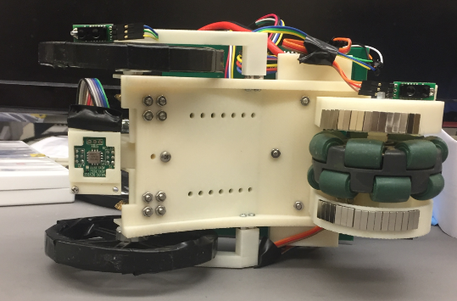
Three-Wheeled Design
Two motorized wheels in the front and passive omni-wheel at the back
Permanent magnets
Surround motorized wheels
Adjacent rear omni-wheel
Notes:
Sean

Slide 11
Mobility Choice: Three-Wheeled Design
Pros
Retains capabilities of old flexure-based design
Turn in place capability
Less weight and power consumption compared to original design
Cons
Omni-wheel provides less stability
Currently lacks ability to traverse 90° angle
Potential Solution:
Leverage Arm
Motorize back wheel
Notes:
Sean

Slide 12
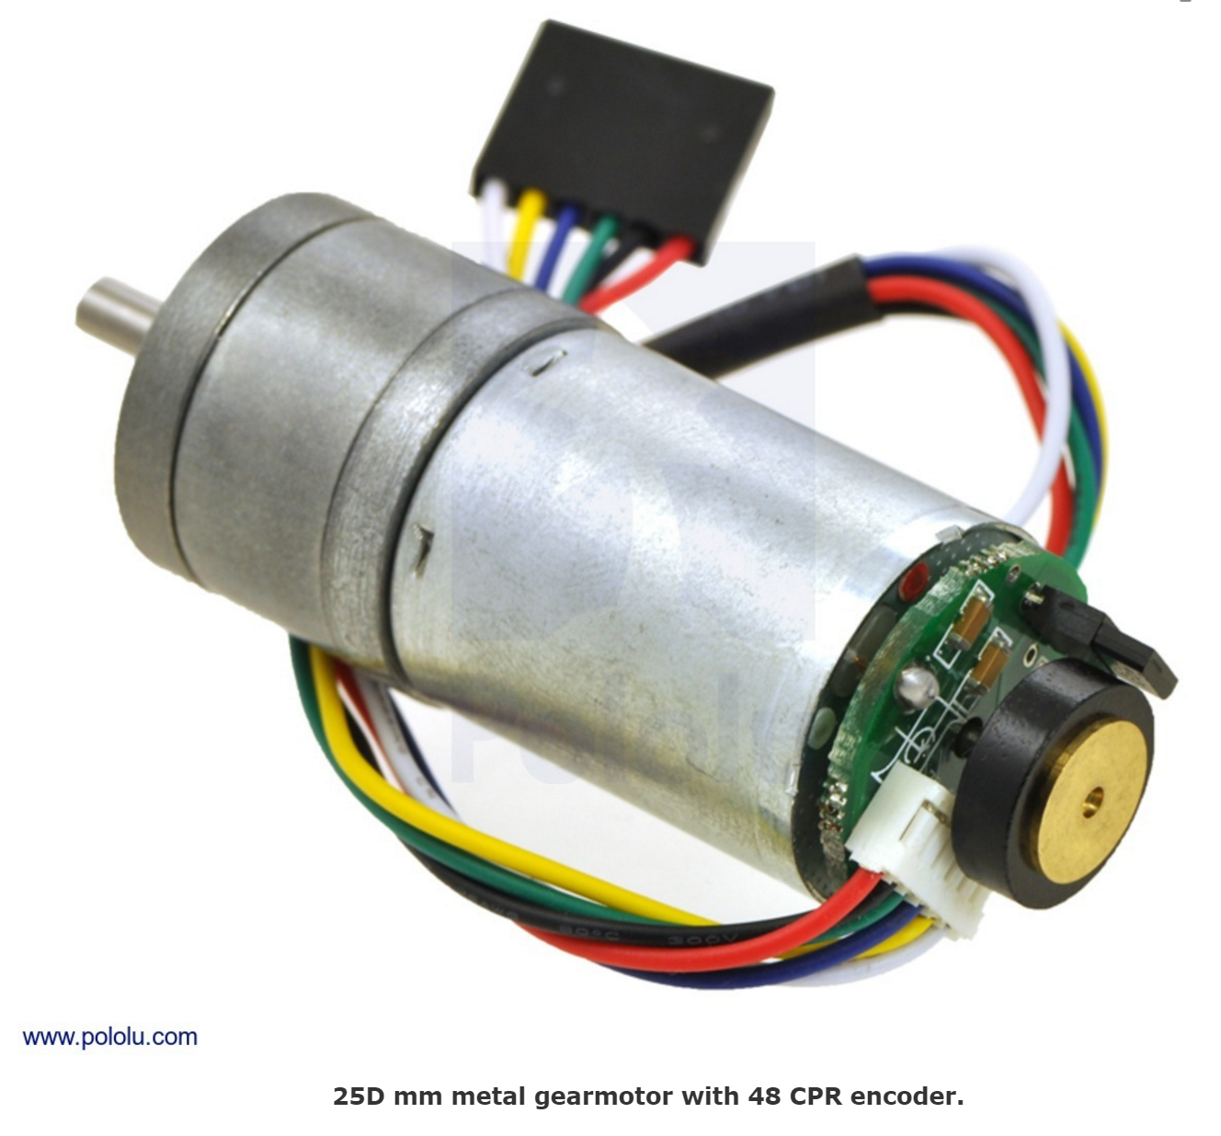
Motors - Pololu 25D Metal Gearmotor
Motor includes encoder with 1200 counts per revolution
Includes low power option at 12V
Free-Run Speed: 55 rpm
Free-Run Current: 100 mA
Provides high torque needed for vertical traversal
Stall Torque: 115 oz∙in
Stall Current: 1110 mA
Notes:
Sean

Slide 13
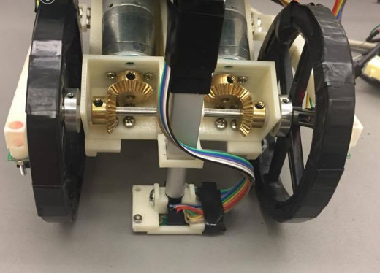
Motors - Implementation
Motors placed in line with length of robot in order to minimize width
Two beveled gears used to transfer motion 90° to wheels
Encoders provide 1,200 counts per rotation of the wheel
Travelling one meter returns 4000 counts per wheel
Magnets are placed along the surface of the wheel
Keeps robot attached to bridge on any surface
Notes:
Sean

Slide 14
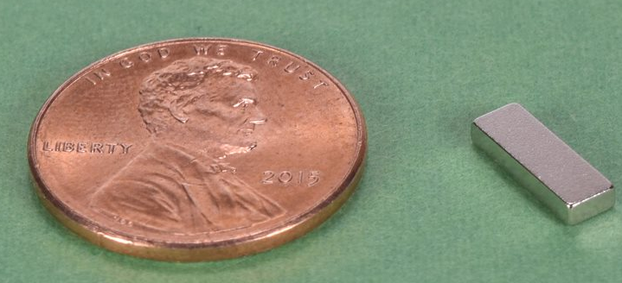
Magnets - B621 Grade N42 Neodymium Magnet
Material: NdFeB, Grade N42
Weight: 0.36 g/magnet
Dimensions: 3/8” x 1/8” x 1/16” thick
Holding Force: 1.15 lbs.
Initial magnet choice was too large and too strong
Motors had trouble producing enough torque to overcome holding force
Due to size, initial magnets surrounding the wheel circumference turned the wheel into a polygon
Chosen magnet was half the width to form a more uniform circle
Notes:
Justin

Slide 15
Accelerometer
Notes:
Erikzzon

Slide 16
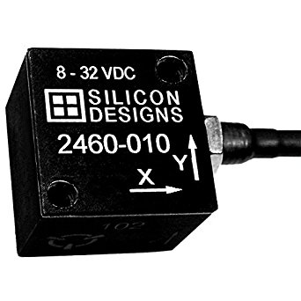
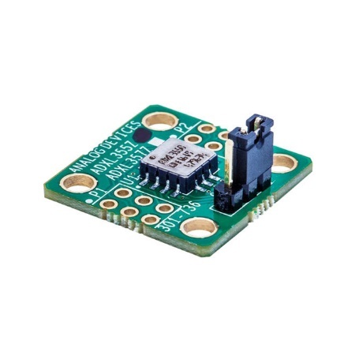
Accelerometer Design Choices
Parameters | Initial Accelerometer: Silicon Designs 2460-002 | Final Accelerometer: Analog Devices ADXL355
Acceleration range | ±2g | ±2.048 g
Frequency Range | 0-300Hz | 0-10,000Hz
Resolution: | 38 ng/bit (with 2000x gain) | 3.8ug/bit
Noise Specification: | 10 μg/√Hz (before signal conditioning and A/D) | 25 μg/√Hz
Operating Power: | 276 mW (without A/D) | 495 μW
Mass | 21 g (without cabling and A/D) | ~5 g
Notes:
Erikzzon

Slide 17
Reason for Accelerometer Change
Noise Floor Requirements relaxed upon further conversations
MRDC Bridge very small in comparison to other bridges
Higher sensitivity needed for small structures
Digital over Analog
Initial trepidation due to unfamiliarity
Much less noise than analog
Controlled environment within one module
I2C bus hard to create noise in
Can easily change digital filter parameters
No PCB for signal conditioning module needed
Faster prototyping
Notes:
Erikzzon

Slide 18
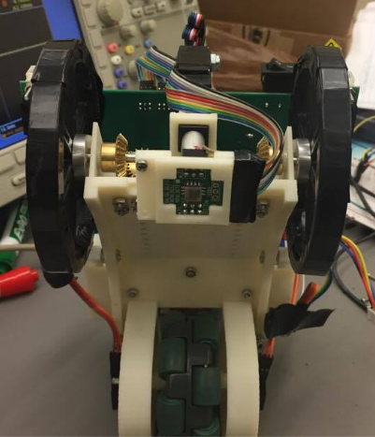
Accelerometer Deployment Method
Requirements
Accelerometer shall mount directly onto bridge
Accelerometer shall be flush with bridge to ensure accuracy of measurements
Design incorporated vertical motion w.r.t. the Bridge Inspection Robot frame
Notes:
Erikzzon

Slide 19
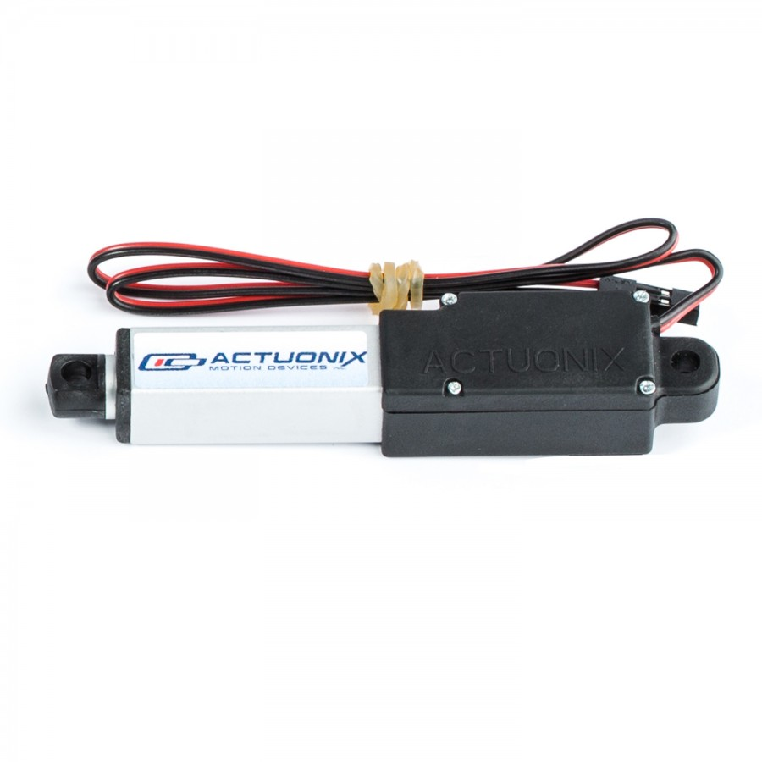
Linear Actuator - Actuonix L12 30mm Linear Actuator
Prepackaged solution
Very low mass
Potentiometer already available for control
Gear Ratio: 210:1
Max Force: 80 N
Stall Current @ 12V: 180 mA
Control: RC
Notes:
Erikzzon

Slide 20
Deployment
Feedback not useful for control
210:1 Gear Ratio made Linear Actuator was able to lift robot up off of magnetized surface
Solution was to set input value to match the accelerometer position to exactly level with the contact surface of the wheels.
Accelerometer deployed inverted along the z-axis
Allowed for accelerometer on board to be directly in contact with measurement surface
Z-Axis Data only needed to be multiplied by -1 in post-processing to resolve
Notes:
Erikzzon

Slide 21
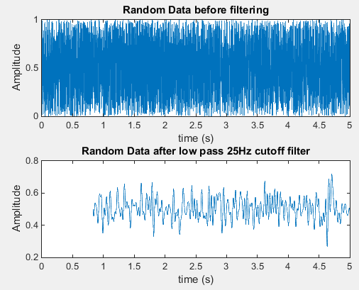
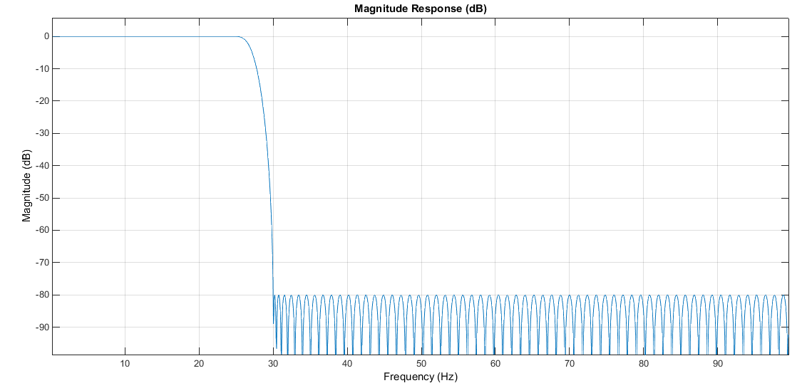
Digital Filter Parameters Option
Digital Filtering through Matlab
firceqrip() or firgr()
FIR Filter
Linear phase delay
Notes:
Sanmesh

Slide 22
Motion Tracking
Notes:
Sanmesh

Slide 23
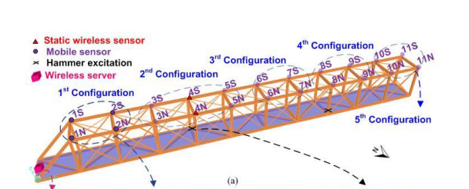
Motion Tracking Requirements
Assumptions
Initial orientation is known
Only straight path traversal is required for the most part, with turning used for path corrections
Requirements
Need to go in a roughly straight path so robot won’t need to continuously correct path
Need to be able to detect edges so robot won’t fall off
Need to be able to identify locations of structural health measurements to around about 2m resolution fairly accurately as in experiment in thesis paper
Notes:
Sanmesh

Slide 24
Straight Path Traversal
Encoders alongside proportional control used to maintain straight path
Drift likely minimized due to permanent magnets holding wheels and robot body to metal surface
Potential drift still a concern
No permanent reference point
Plans to implement gyroscope in design for future use
Notes:
Sanmesh

Slide 25
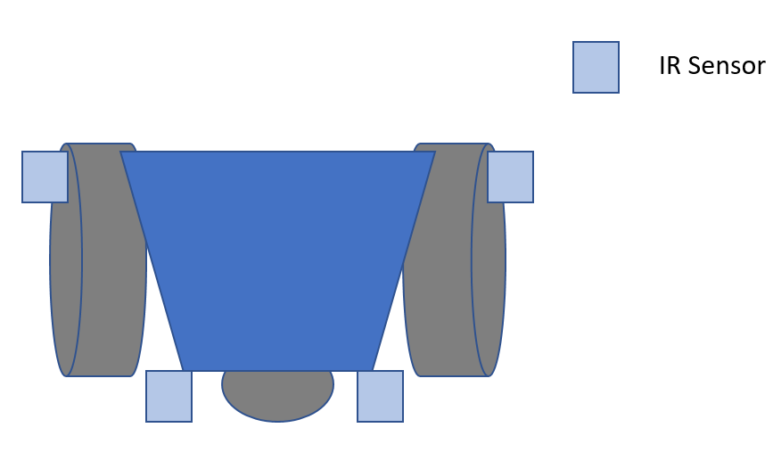
Edge Detection
IR Sensors
Four IR sensors mounted close to wheels and near edge
Verified that wheels will hit inclines such that sensors will not scrape against surfaces
IR
Notes:
Sanmesh

Slide 26
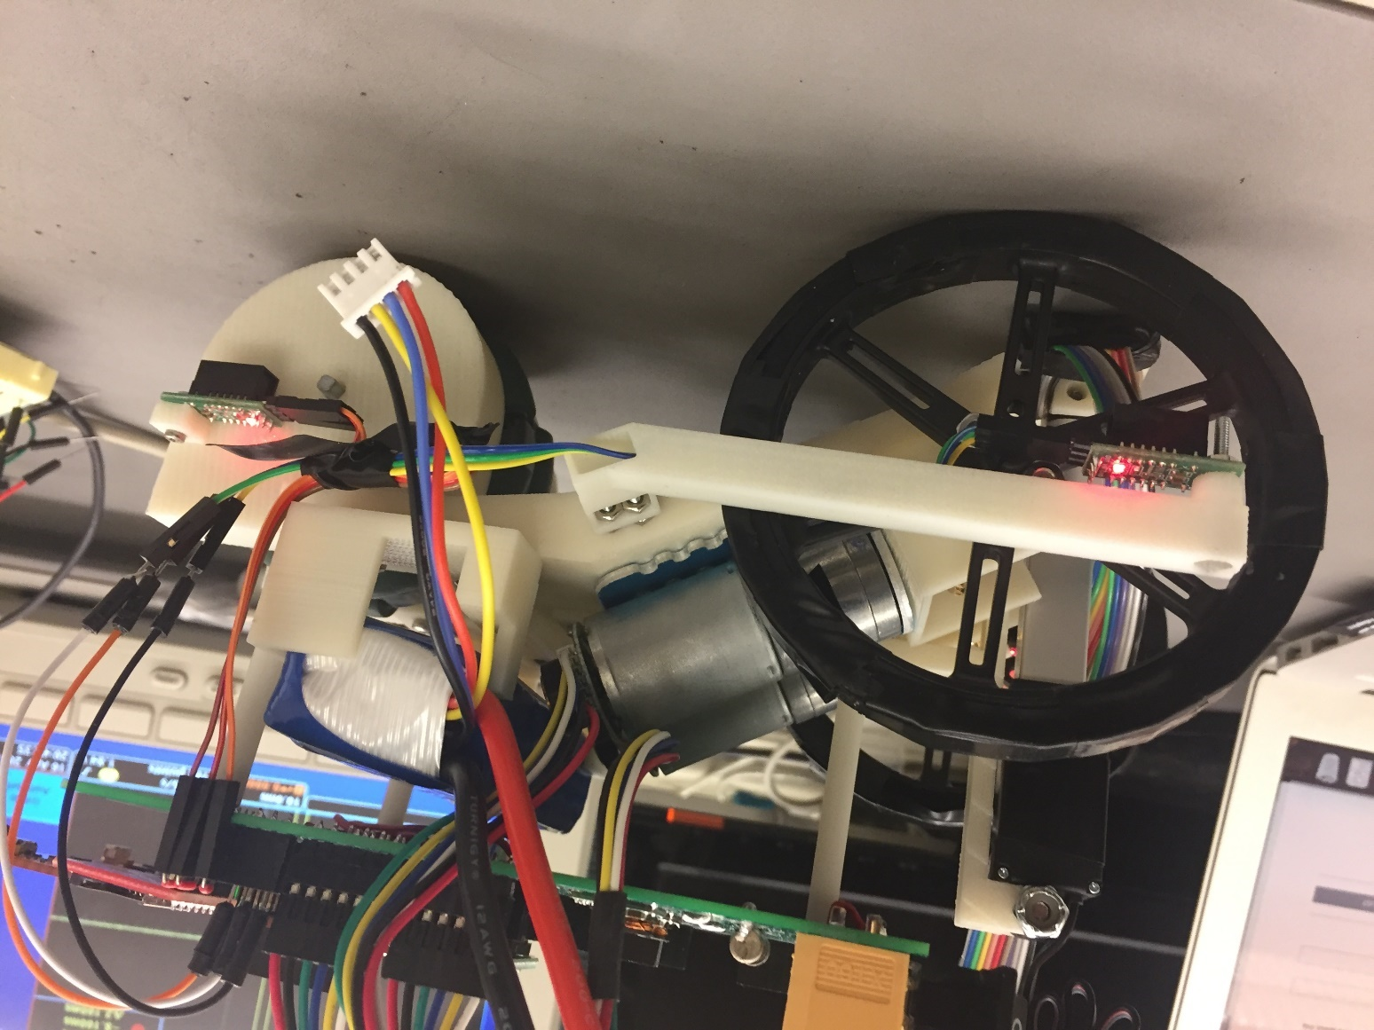
IR Sensor Implementation
Notes:
Sanmesh

Slide 27
Motion Tracking
Used encoder movement, combined with GPS for absolute position recalibration every 50m
Further minimizes effect of encoder drift
Not useful if on underside of bridge without clear line-of-sight of the sky
Incorporate gyroscope in a future robot iteration
Notes:
Sanmesh

Slide 28
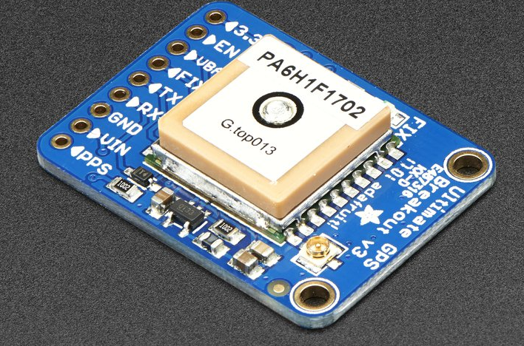
GPS - Adafruit Ultimate GPS Breakout - 66 Channel MTK3339
Accuracy: 3 m radius
Update Frequency: 10 Hz
Sensitivity: 165 dBm
Power: 100 mW
Interface: UART
Other
Ships with breakout board
Built-in data-logging
SMA connector to connect external antenna
Notes:
Sanmesh

Slide 29
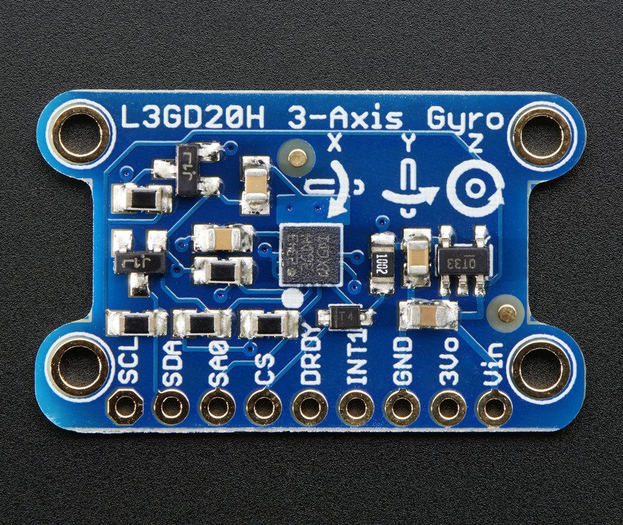
Gyroscope – ST L3GD20H
X-, Y-, Z-axis data
Resolution: ±245/±500/±2000°/s with 16 bits
Accuracy: Zero Bias: ±25°/s
Power: 15 mW
Interface: SPI/I2C
Other: User-enabled integrated low-pass and high-pass filters; Temp sensor.
Notes:
Sanmesh

Slide 30
Data Storage
Notes:
Justin

Slide 31
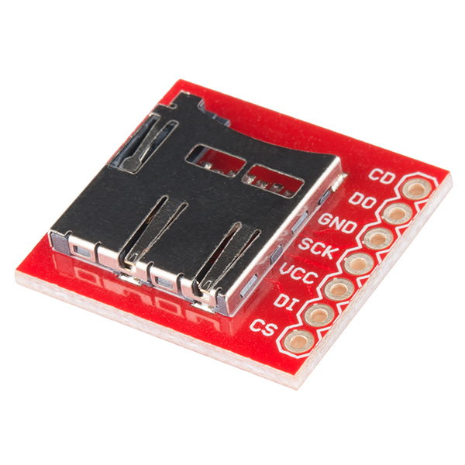
SD Card – Sparkfun microSD Breakout
Connects SanDisk Class 4 16 GB microSD card to MSP432
Capable of storing over 370 hours of accelerometer data at a sample rate of 1000 Hz
Interfaced via SPI
R/W Speed: 1 MHz
Notes:
Justin

Slide 32
Wireless Communication
Notes:
Justin

Slide 33
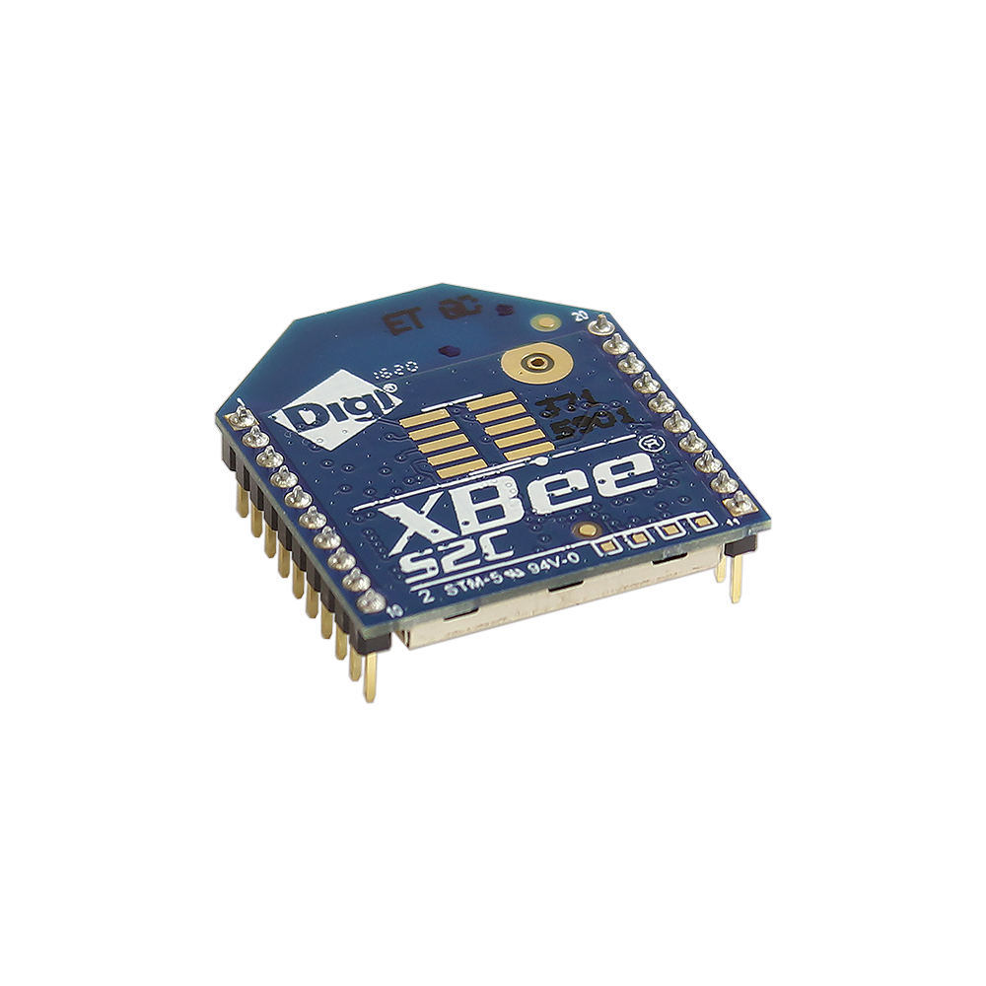
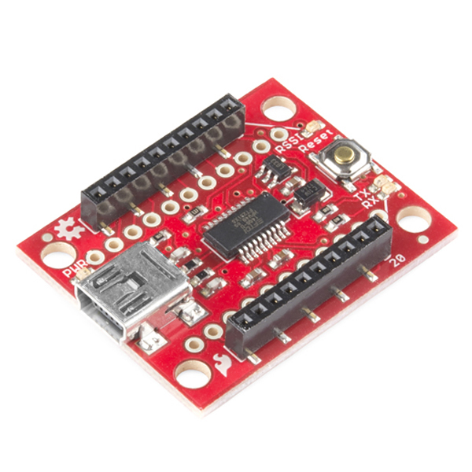
Wireless Module - XBee S2C 802.15.4
Specifications
Max outdoor range: 1200 m
Throughput: up to 250 Kbps
Interface: UART
Current draw (typical): 28-33 mA
Wireless Protocol: IEEE 802.15.4
Switched from Digimesh
Communicates with PC through a Sparkfun XBee Explorer USB
Notes:
Justin
Outperforms the wireless module of the previous robot in all aspects - range, throughput, current draw, etc.
We later learned that a point-to-multipoint protocol is more desirable for synchronized nodes, but Digimesh is a mesh protocol that does not guarantee that every node will receive commands at the same time.
Initially, we were going to interface with the XBee via SPI,but UART proved to be simpler.

Slide 34
Power
Notes:
Sean

Slide 35
Power Requirements
Power requirements were mainly dependent on the following:
Motors
Wireless Communication
Accelerometer
Accelerometer Deployment
The robot was expected to run actively for at least one hour and one additional hour while stationary
The robot required a maximum voltage of 12V to accommodate the accelerometer and motors. Power conversion circuitry used to create lower voltages for other components
Notes:
Sean

Slide 36
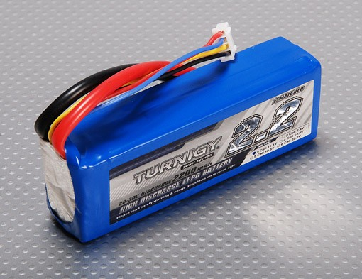
Turnigy Lipo Pack
Minimum Capacity: 2200mAh (True 100% Capacity)
Configuration: 3S1P / 11.1v / 3Cell
Weight: 188g
Provides a high continuous current and long lifetime
Notes:
Sean

Slide 37
Robot Structure
Notes:
Sean

Slide 38
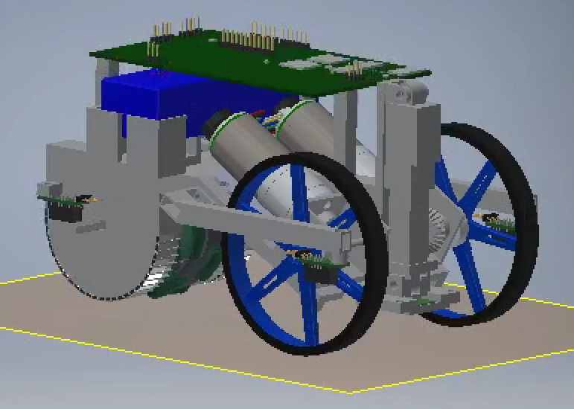
Structure
A holding structure is needed for battery and circuitry
Structure was rapidly prototyped using Inventor 2017 and 3D printing with the Senior Design Lab
Alternate Consideration
Aluminum or acrylic sheets are used for a high strength support, designed in Inventor 2017 and machined at the invention studio.
Notes:
Sean

Slide 39
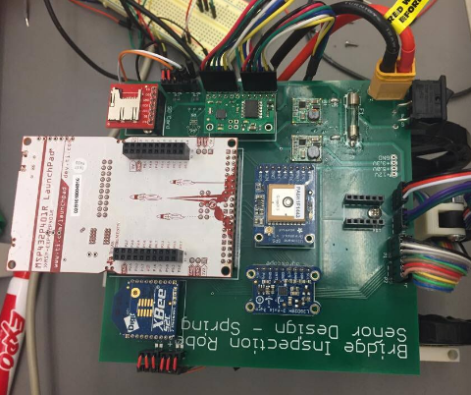
Printed Circuit Board (PCB)
Designed using the educational license of Autodesk EagleCAD
Single circuit board for power, data transmission, and motor control
Used for routing signals between subsystems
Implements modular design to allow detachment or replacement of major components
Notes:
Sean

Slide 40
Microcontroller
Notes:
Justin

Slide 41
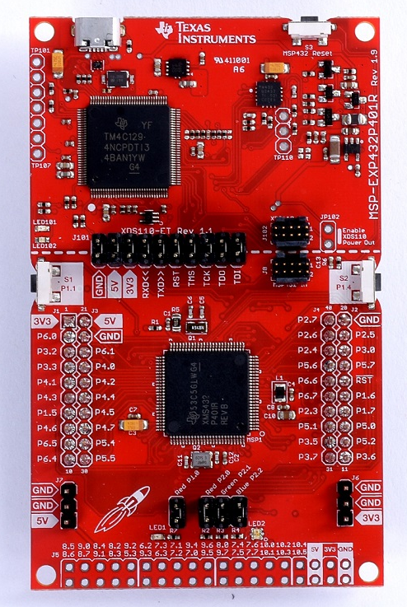
Microcontroller – TI MSP432P401R
Specifications
48 MHz ARM 32-bit CPU
256 kB of flash memory
64 kB SRAM
14-bit ADC
4 UART channels and 4 SPI channels
Current draw (active mode, typical): 7.8 mA
Programmed via Code Composer Studio IDE
MSP432 Launchpad used for rapid prototyping
Notes:
Compared to MCU of previous robot: 8 Hz 8-bit MCU, 128 kB flash, 4 kB SRAM, 10-bit ADC, 17 mA current
Justin

Slide 42
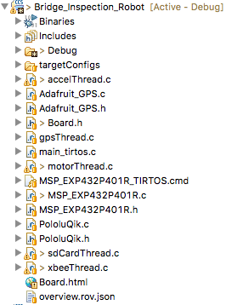
Software
Written in C
TI-RTOS: a proprietary RTOS for TI MCUs
Libraries for GPIO, ADC, UART, SPI, Timers, etc.
Separate threads for different components
Mutexes, semaphores, and barriers sync and coordinate actions
External libraries for motors and GPS ported from Arduino to MSP432
Notes:
Justin

Slide 43
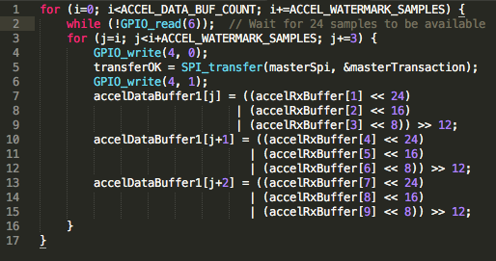
Datalogging Program
A "sample" consists of an X-value, Y-value, and Z-value
Accelerometer provides sequential data in sets of 8 samples
Double buffer system on MSP432, each holding 1536 samples
Accelerometer fills one buffer with data while SD card is filled with the other buffer's data
Notes:
Justin

Slide 44
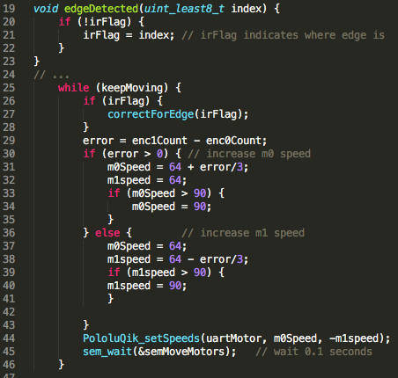
Movement Program
While motors are running...
Encoder counts are incremented/decremented via interrupts
Running timer regulates proportional control on the motors
IR sensors halt forward progress if edge detected
Motors stop when the desired encoder count (distance) is reached
Notes:
Justin

Slide 45
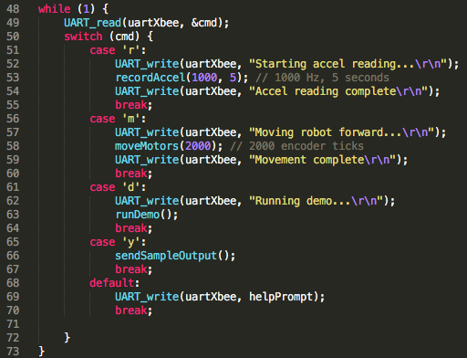
User Interface Program
Commands are sent through a serial port (XBee)
Accelerometer data is streamed back at 115200 baud
Data can be piped to a MATLAB program for automatic plotting
Notes:
Justin

Slide 46
Design Verification
Characteristic | Specification
Magnet Holding Force | Holds robot static indefinitely
Operational Lifetime | Movement Operation Time ≥ 1 hour; Recording Operation ≥ 1 hour
Accelerometer Range and Accuracy | 0 – 50 Hz ± 0.5 Hz 50 Hz +/- 0.5 Hz
Robot Size | Greatest side length ≤ 0.25 m
Weight | Total mass ≤ 1 kg
Wireless Communication Distance | Able to send/receive data ≥ 800 m
Path Following | Shall not fall off edge in “sunny day” conditions
Notes:
Erikzzon

Slide 47
Dimension and Mass Properties
 | Required Specification | Actual Specification | Requirement Met?
Dimensions | <= 25cm by 25cm by 25cm | 24cm by 14cm by 20cm | YES
Weights | 1 kg | 1.084 kg (5-7% overshoot on scale) | No

Slide 48
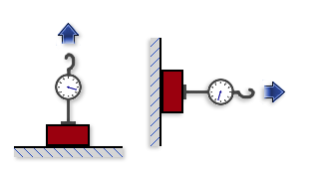
Test Event: Holding Force
Initially proposed test was to check if an individual magnet could maintain its position with mass attached to it for at least 2 minutes
On further discussion, a more representative test would be testing the fully built robot with some mass attached to it in multiple configurations
Requirement is verified if robot can maintain its own mass and position in varying positions
Stretch goal is the robot being able to maintain its position with extra mass attached
Notes:
Erikzzon

Slide 49
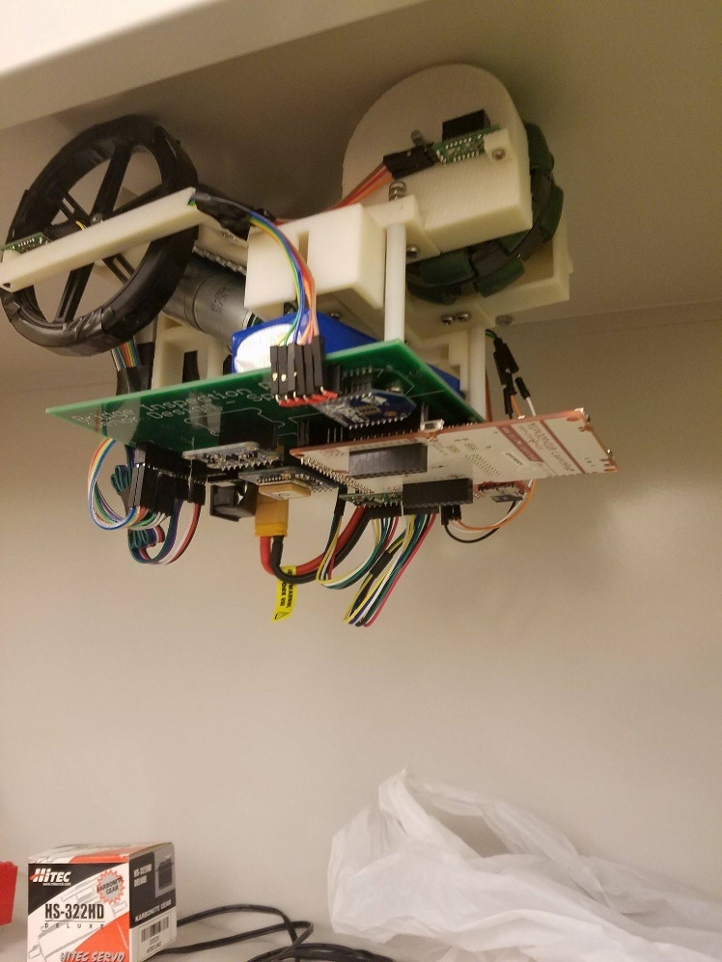
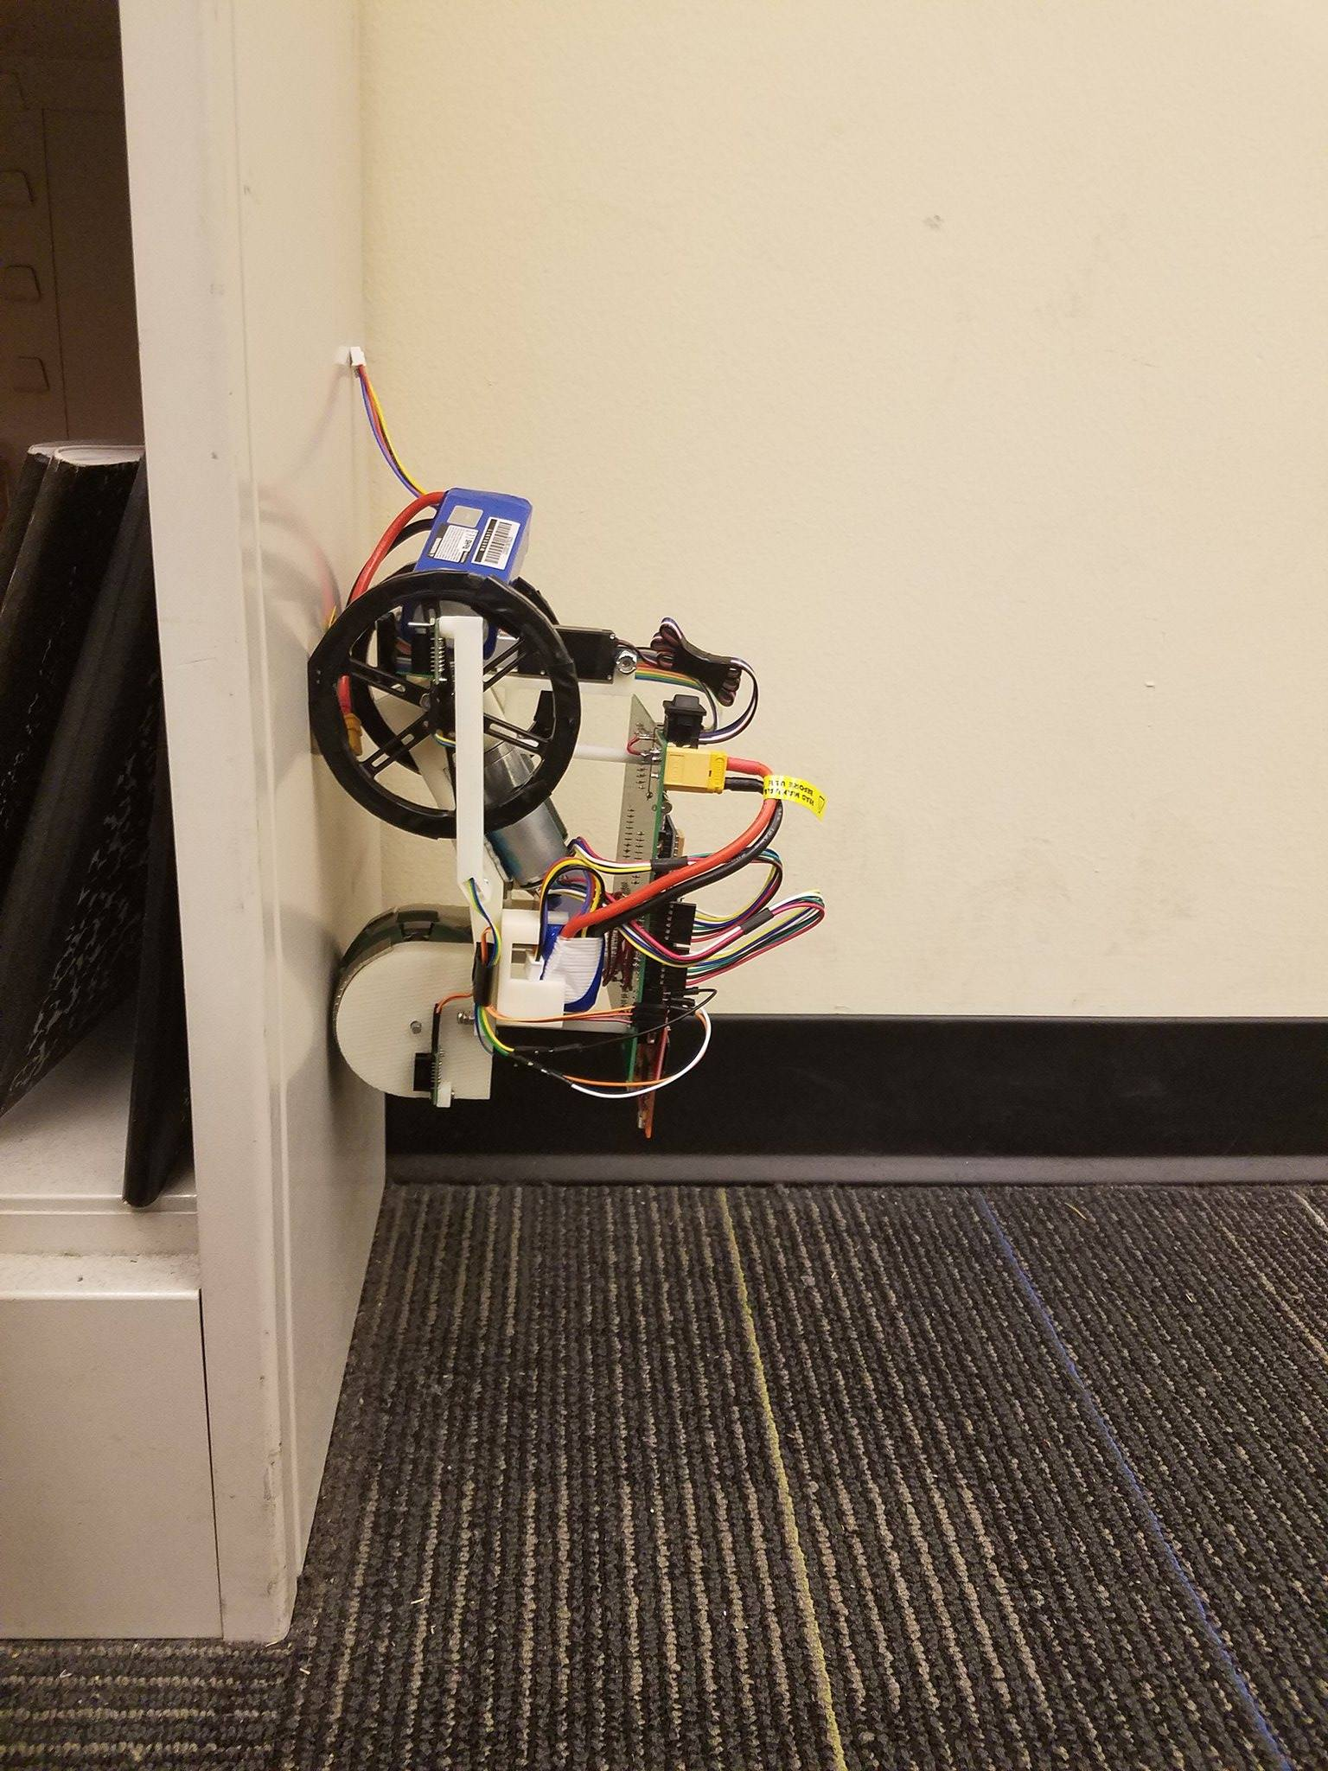
Holding Force Results
Robot upside down: Maintained position for at least 2 minutes
Robot on vertical surface: Maintained position for at least 2 minutes
Robot is more secure if front wheels are on top
If back wheel is on top, increased likelihood of the robot will flip over
If robot is sideways, increased likelihood of back wheel slipping
Notes:
Erikzzon

Slide 50
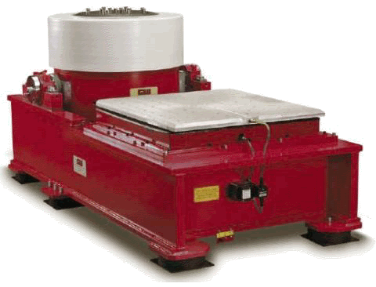
Test Event: Accelerometer Data Accuracy
Verification of the accelerometer data accuracy required usage of a shaker table
A vibration profile will be measured by mounting both a statically mounted accelerometer and the robot with its installed accelerometer on to the table
Notes:
Erikzzon

Slide 51
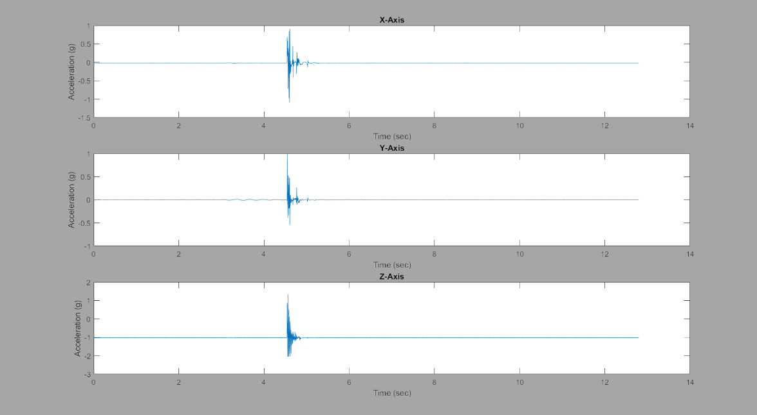
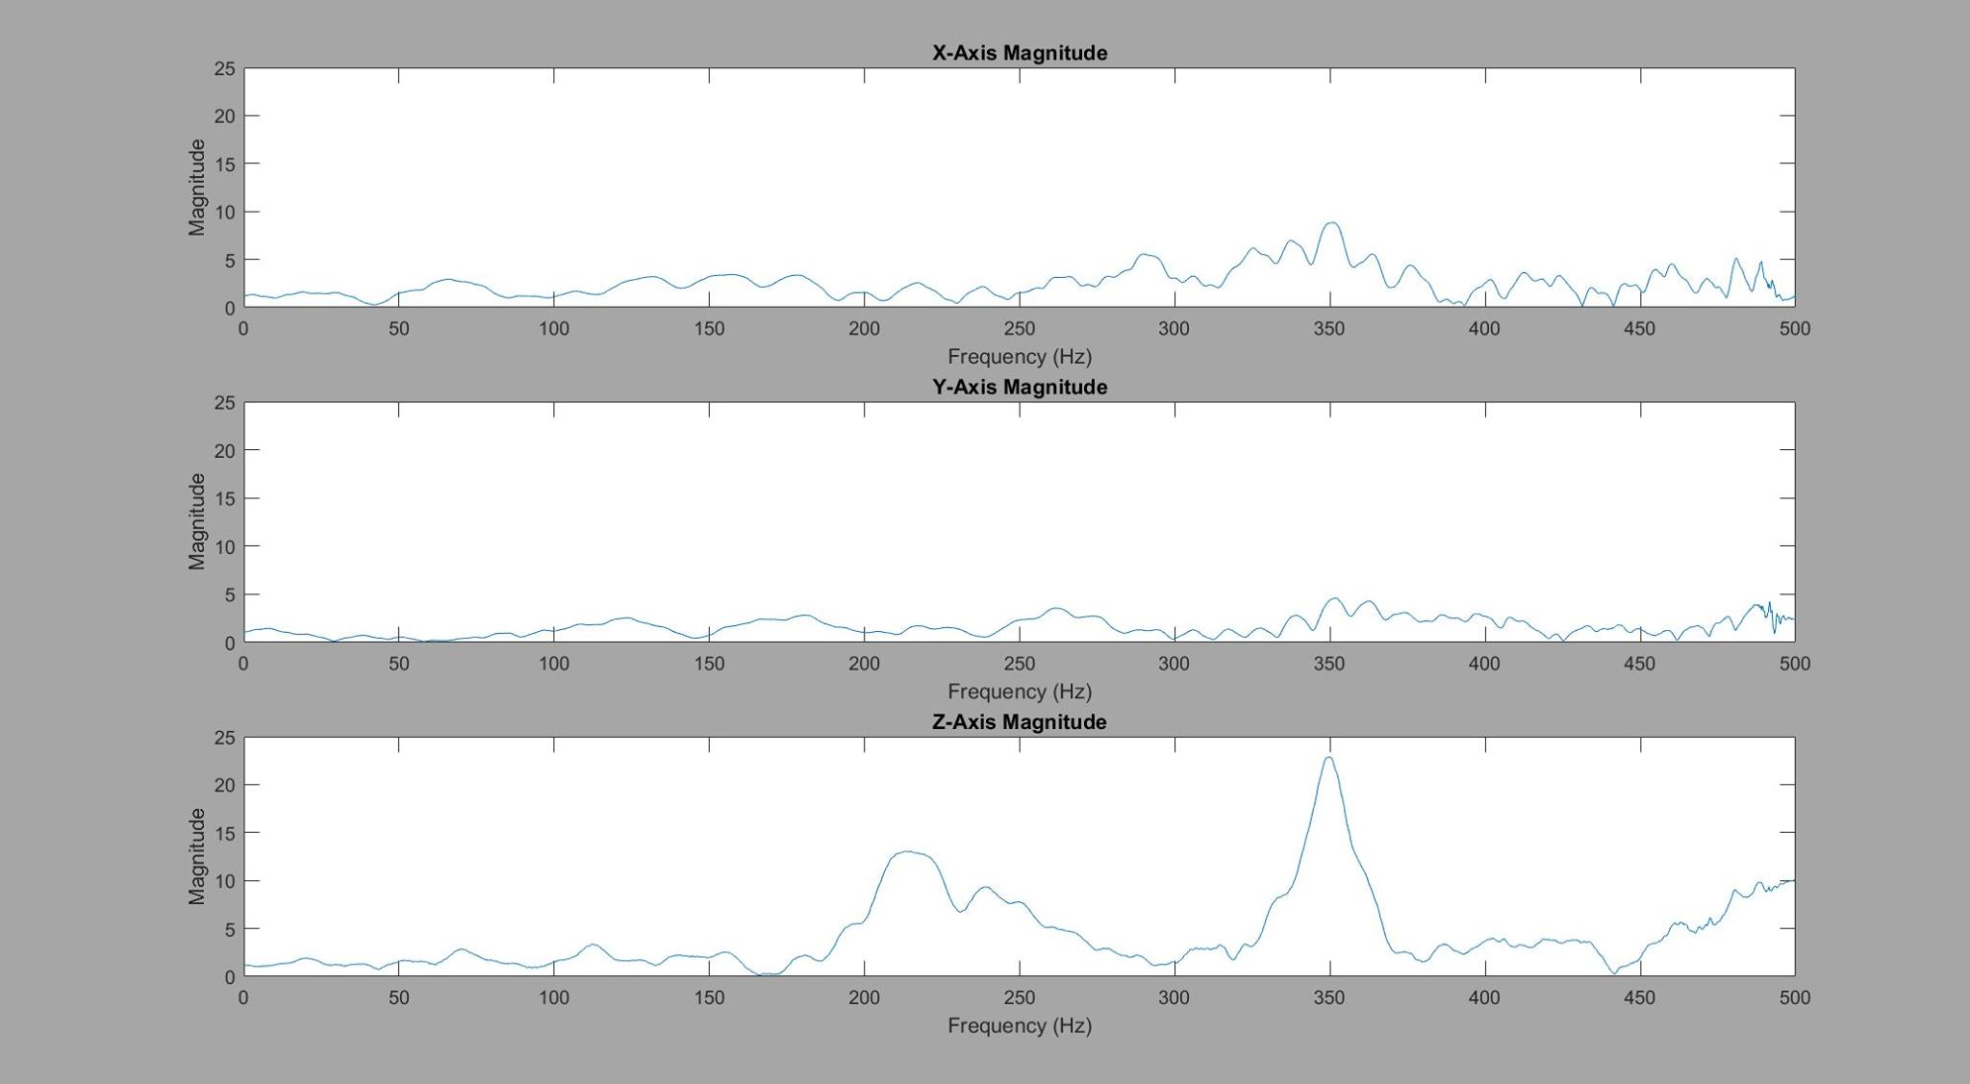
Accelerometer Data Accuracy Results
No official testing event has occurred yet
Based on examination of data while integrating accelerometer into robot design, confident in accelerometer functionality
Data produced is along the appropriate axes
Small perturbations distinct
Notes:
Erikzzon

Slide 52
Test Event: Battery Life
Battery life analysis will be divided into movement operation time and measurement operation time
Movement operation time will be measured by having the motors drive continuously on metal surface as if it were traversing a bridge
Measurement operation time will be measured by having the robot collect ambient vibration data
Requirements will be met if each lifetime surpasses one hour
Notes:
Erikzzon

Slide 53
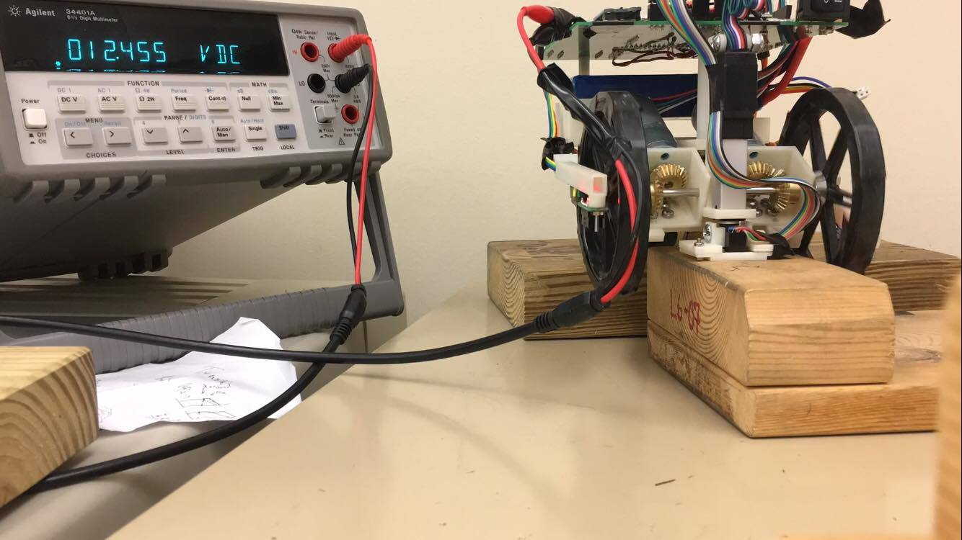
Battery Life Results
Upon further discussion, the highest current draw would be during the robot movement as the motors are driven
By verifying the movement battery life requirement, the measurement battery life requirement is also verified
The robot was set to spin wheels freely while attached to a multimeter
0.25V for 1hr
Not completely representative as there is higher current draw when wheels are under load and magnetized to metal surfaces
Notes:
Erikzzon

Slide 54
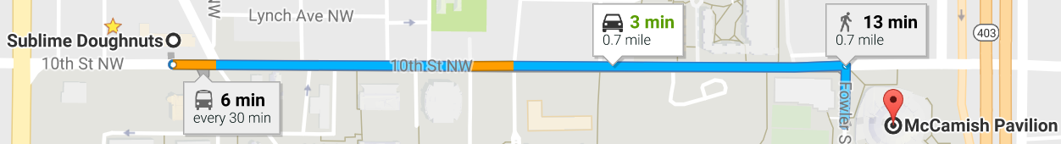
Test Event: Wireless Communication Distance
The robot shall send data at distances varying linearly from 500m to 1000m to a base computer
Communication distance is verified if it can accurately send data at least 800m away from the computer
Notes:
Erikzzon

Slide 55
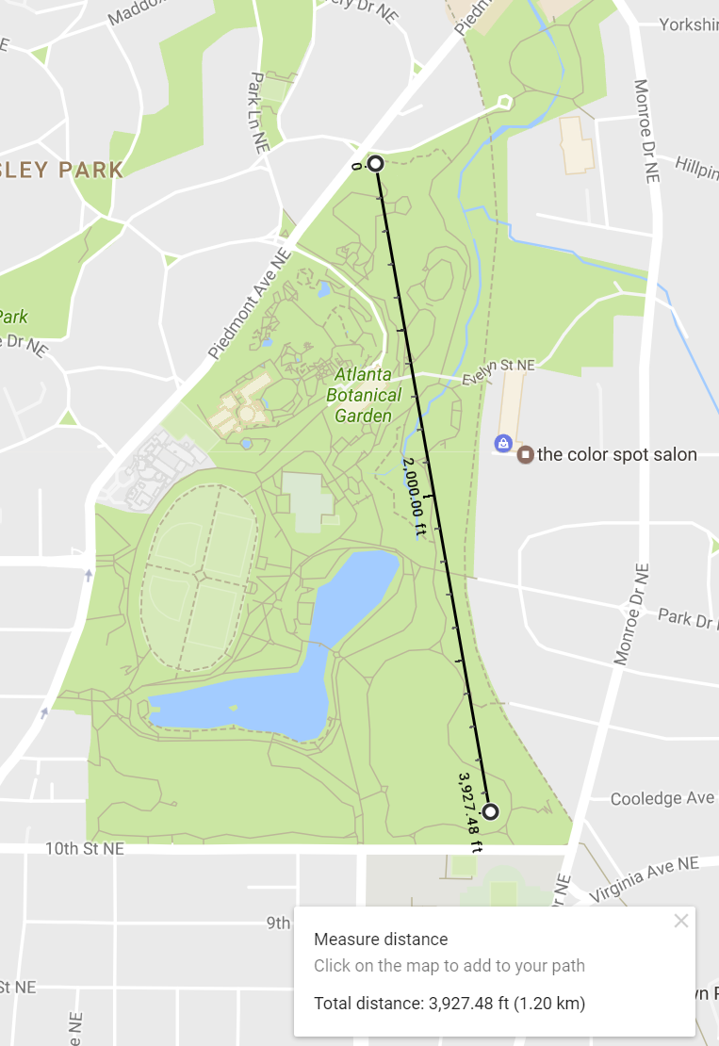
Wireless Communication Distance Results
Initial test sent GPS data back to base computer along 10th Street to the north of Georgia Tech’s main campus
GPS data gave out at approximately 500 m
Concerns regarding the foliage and passing cars obfuscating the signal
Retest to take place at Piedmont Park
More open space and clearer line-of-sight between robot and PC
Notes:
Erikzzon

Slide 56
Test Event: Final Demonstration
The robot will be placed on the MRDC bridge and be expected to traverse to one of the measurement locations in each configuration
At each configuration, the robot will take measurements at one location simultaneously with stationary sensors at the remaining locations and send the data to the base computer
Measurement accuracy will be further confirmed by striking the bridge with a hammer during measurements
Notes:
Erikzzon

Slide 57
Final Demonstration
The “bridge” has been brought to the presentation
The robot shall:
Move along the “bridge”
Stop after moving for four seconds
Robot should not fall off
Deploy the accelerometer
Measure data
Transmit data wirelessly to PC
Data shall be plotted in MATLAB
Repeat the above procedure in triplicate
Notes:
Erikzzon

Slide 58
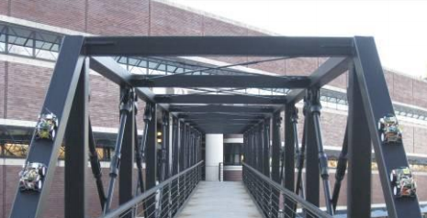
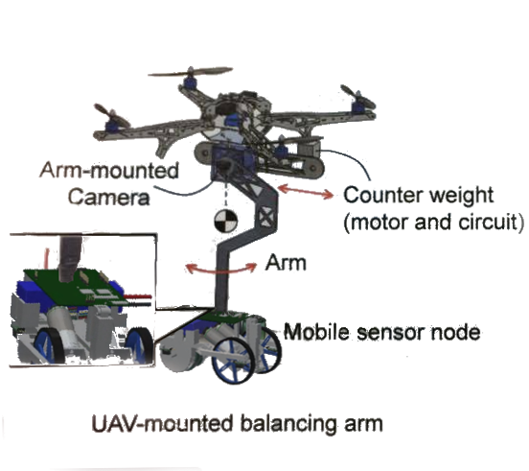
Future Steps
Integrate gyroscope for complex path following
Create network of robots for full mobile sensing network
Modify robot for drone deployment and retrieval
Incorporate localization
Notes:
Kristen

Slide 59
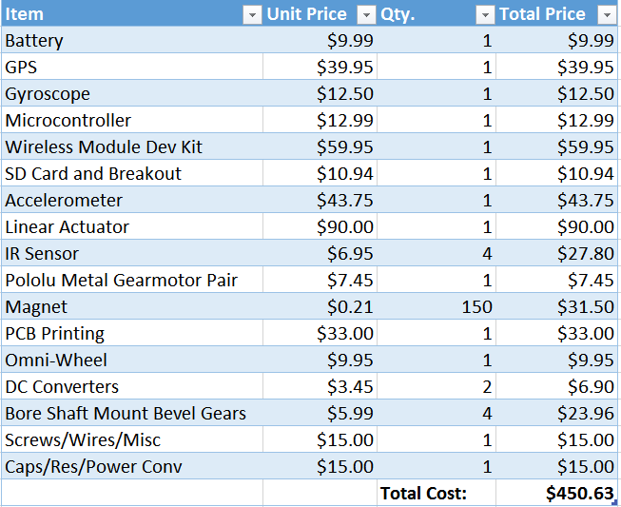
Cost Analysis
Notes:
Kristen

Slide 60
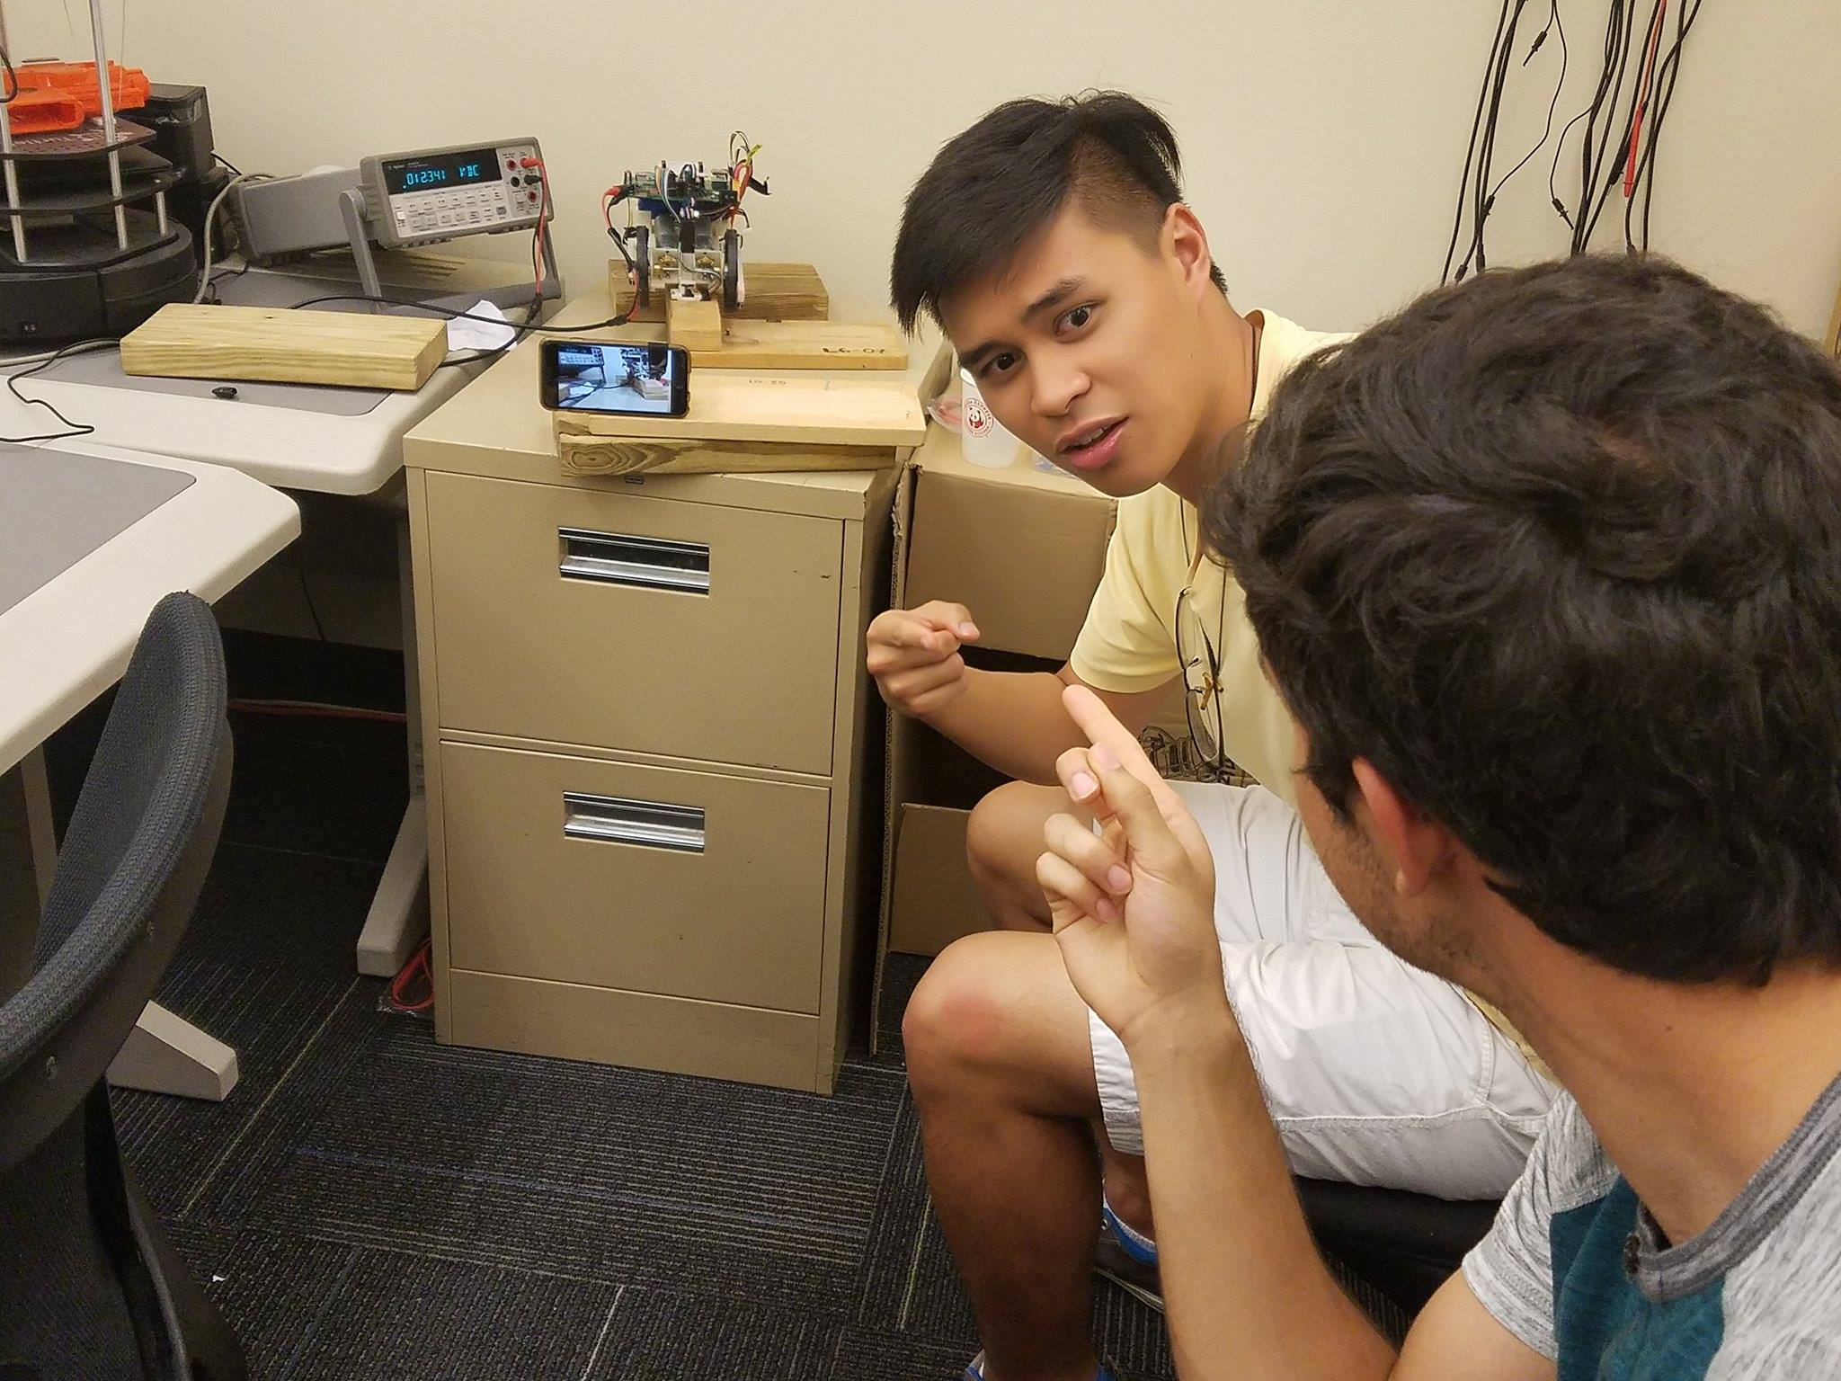
Questions?

Slide 61
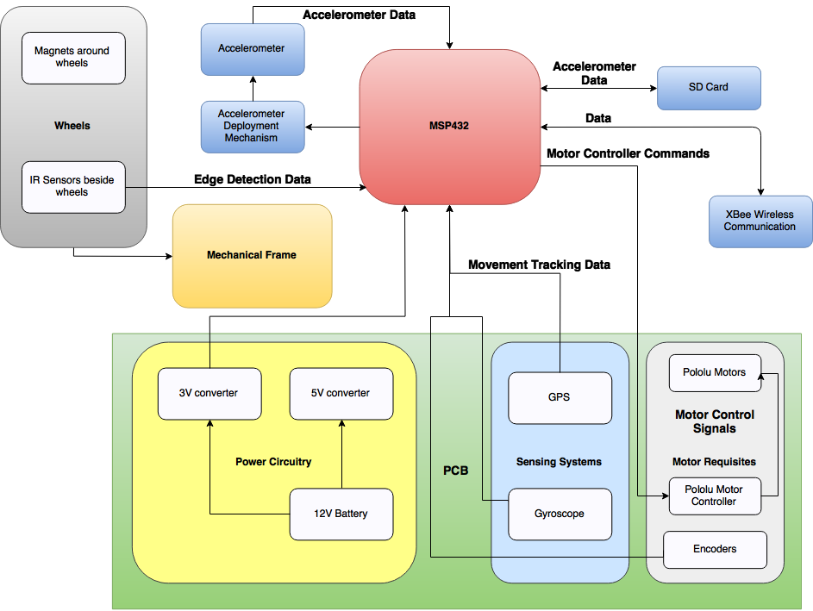

Slide 62
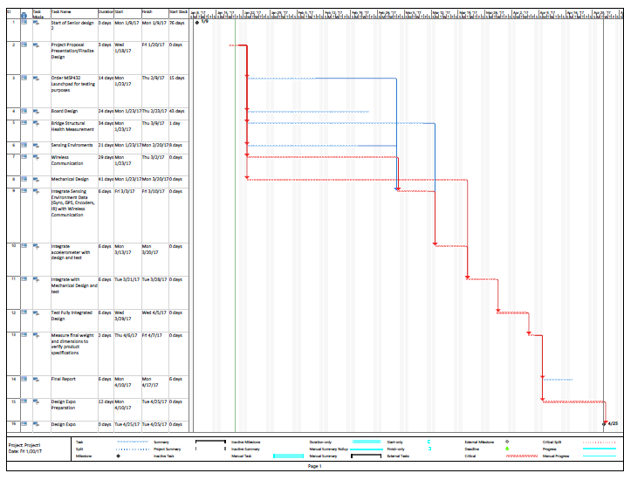
Notes:
Kristen

Slide 63
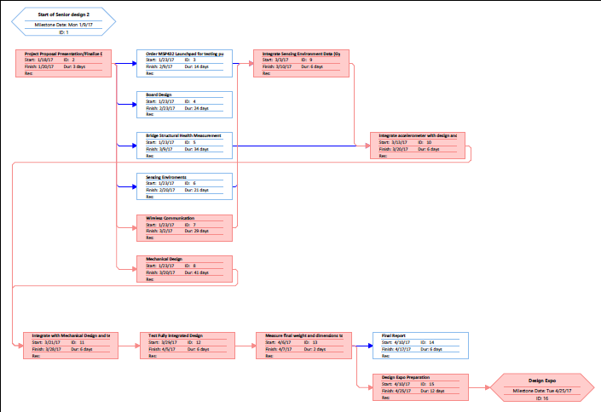
Notes:
Kristen

Slide 64
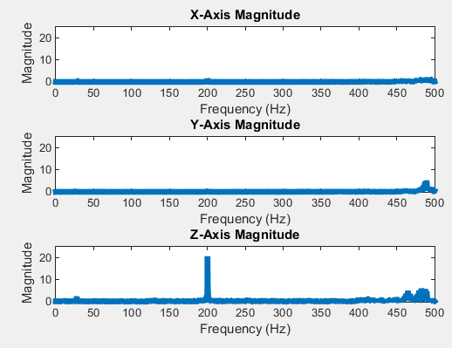
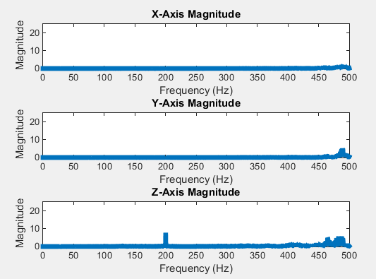
Before Low pass with 0.5 attenuation
After Low pass with 0.5 attenuation

